Slide 1
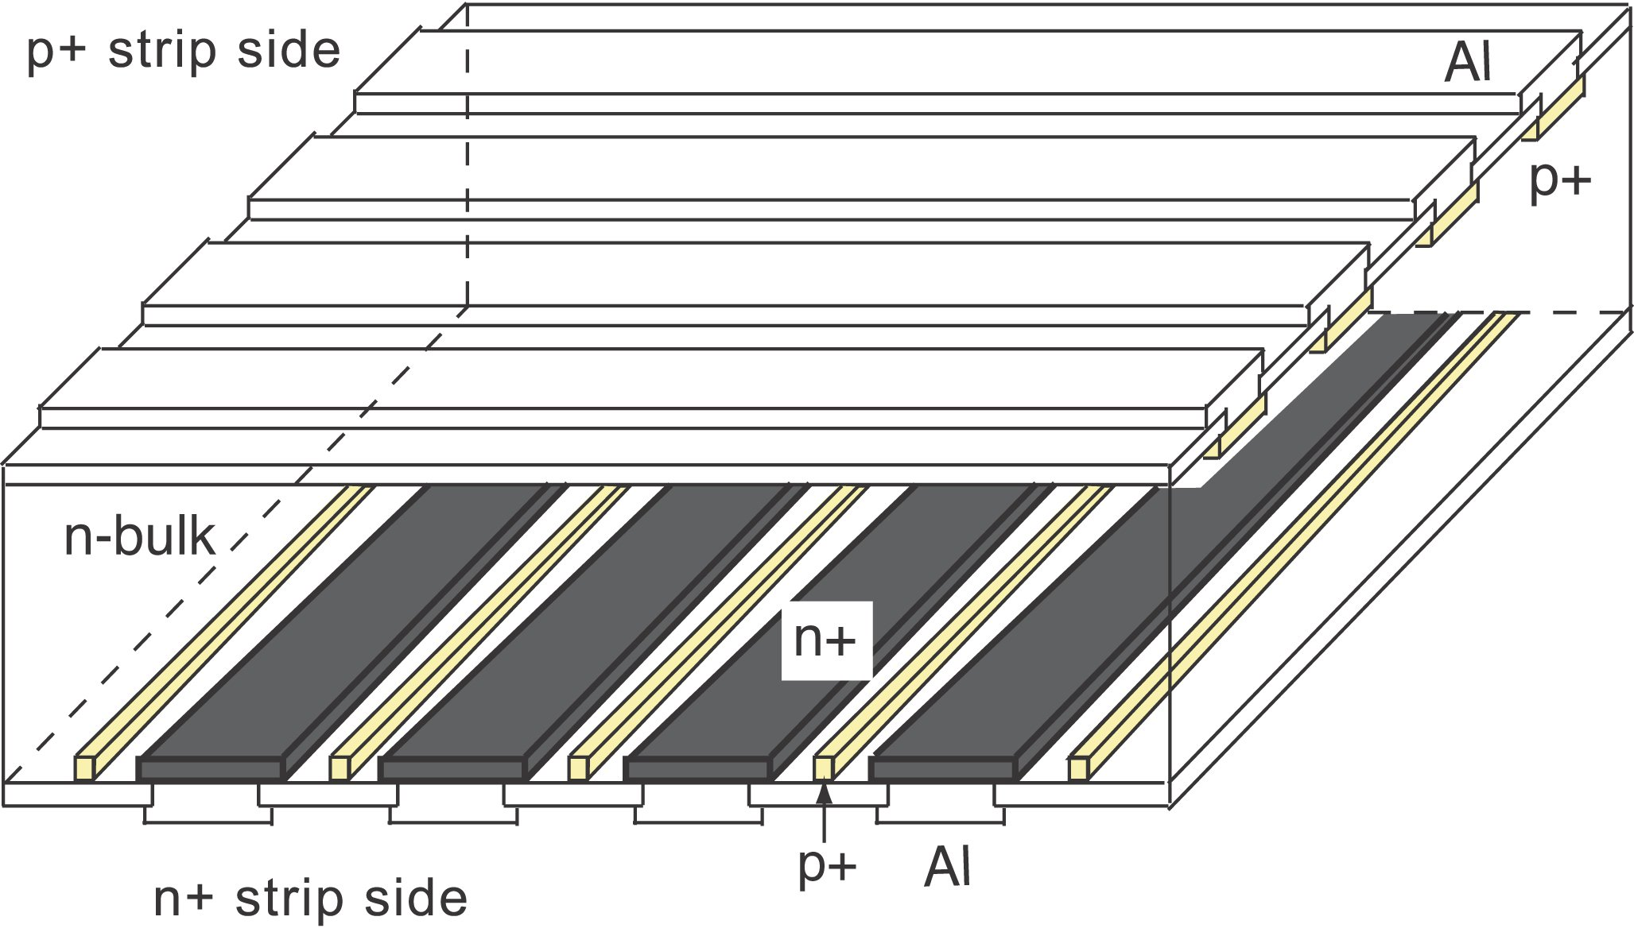
ionizing particle
p⁺
h
e⁻
e⁻
h
V
e⁻
h
n⁺

Slide 4
L = 140 mm
A
B
x
L - x

Slide 5
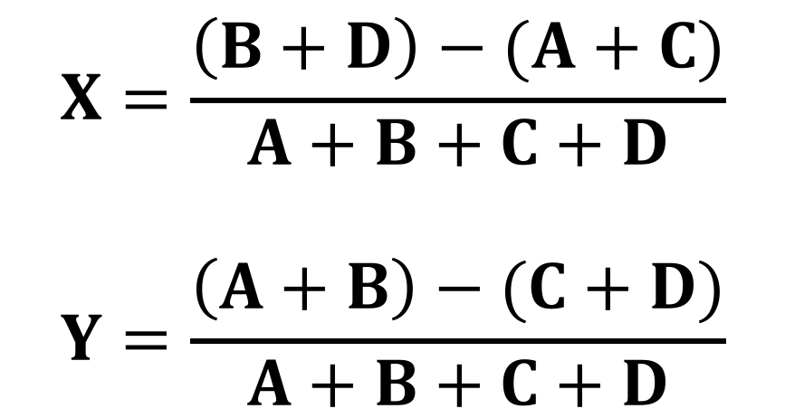
y
30 mm
γ
x
35 mm
A
B
38 mm
C
$$X=\frac{\left(B+D\right)−(A+C)}{A+B+C+D}$$
$$Y=\frac{\left(A+B\right)−(C+D)}{A+B+C+D}$$
D

Slide 6
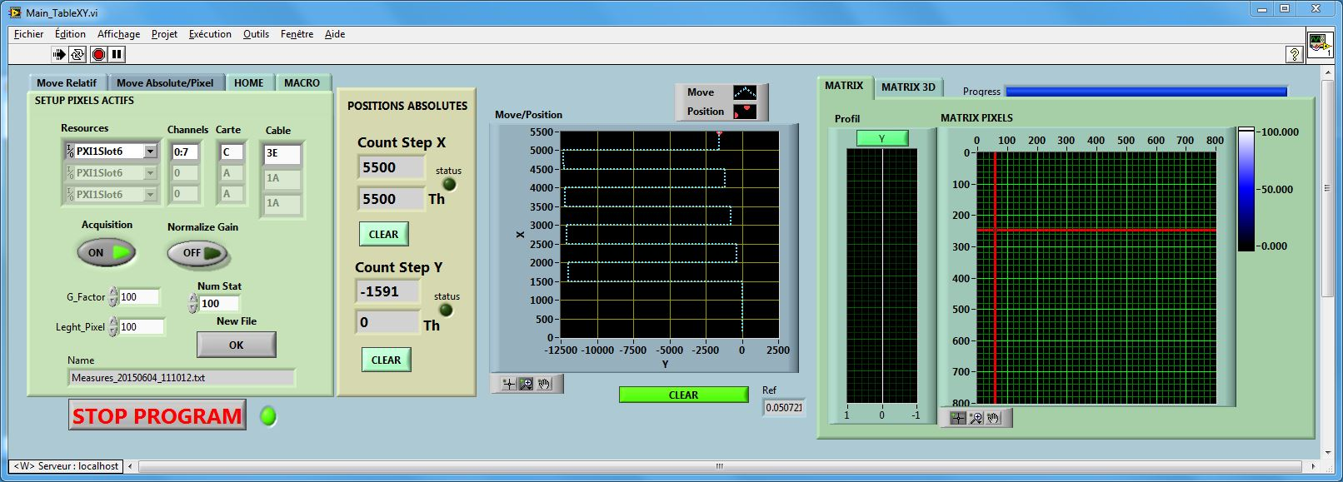
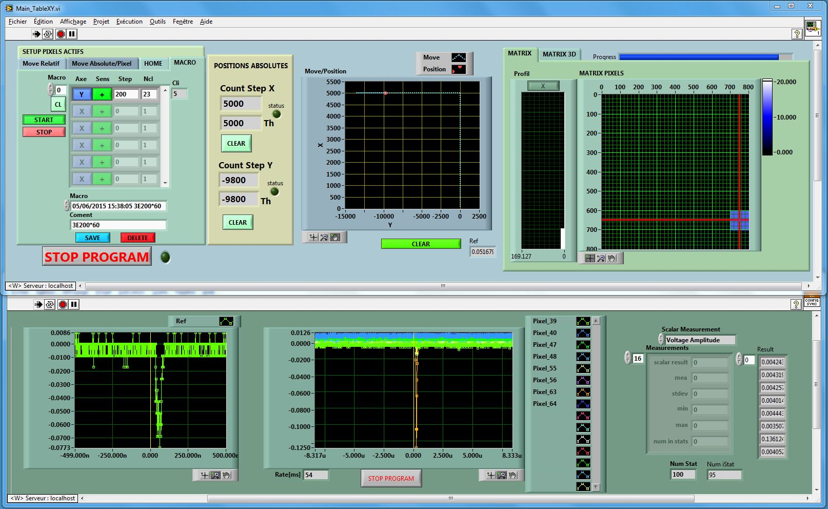

Slide 7
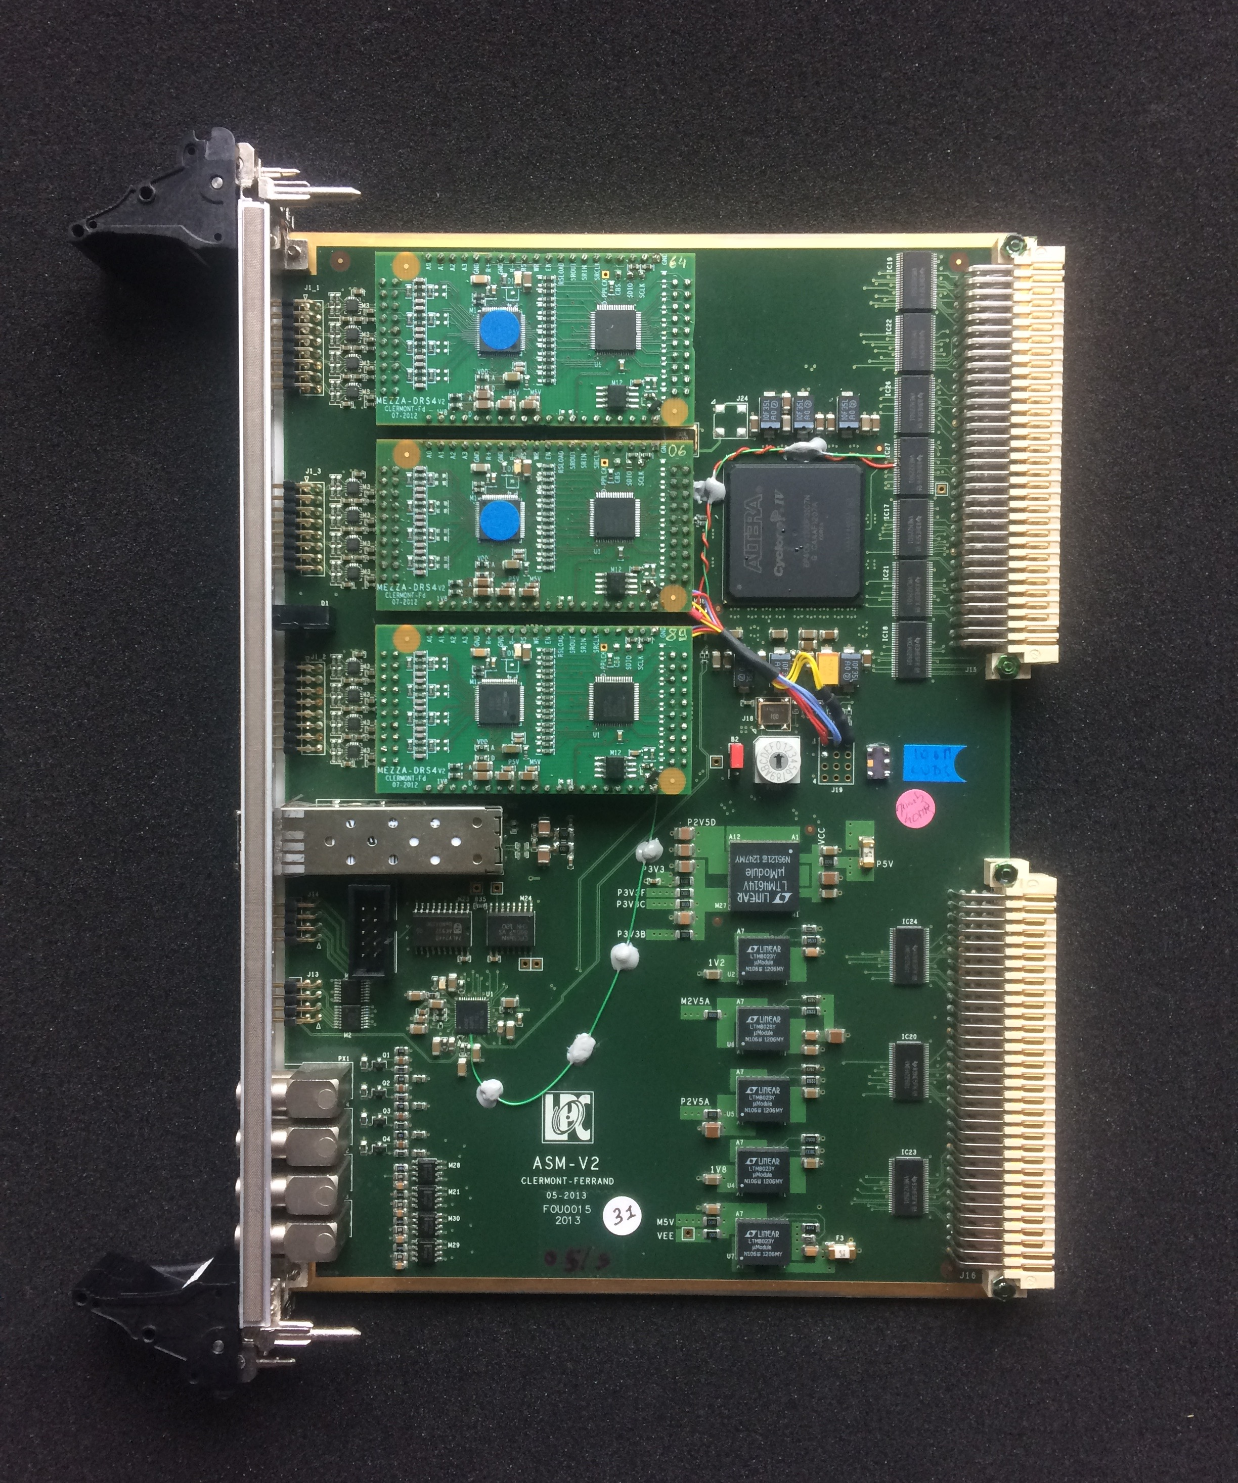
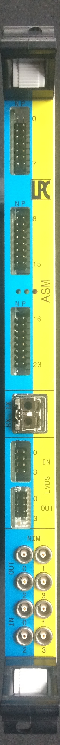

Slide 8
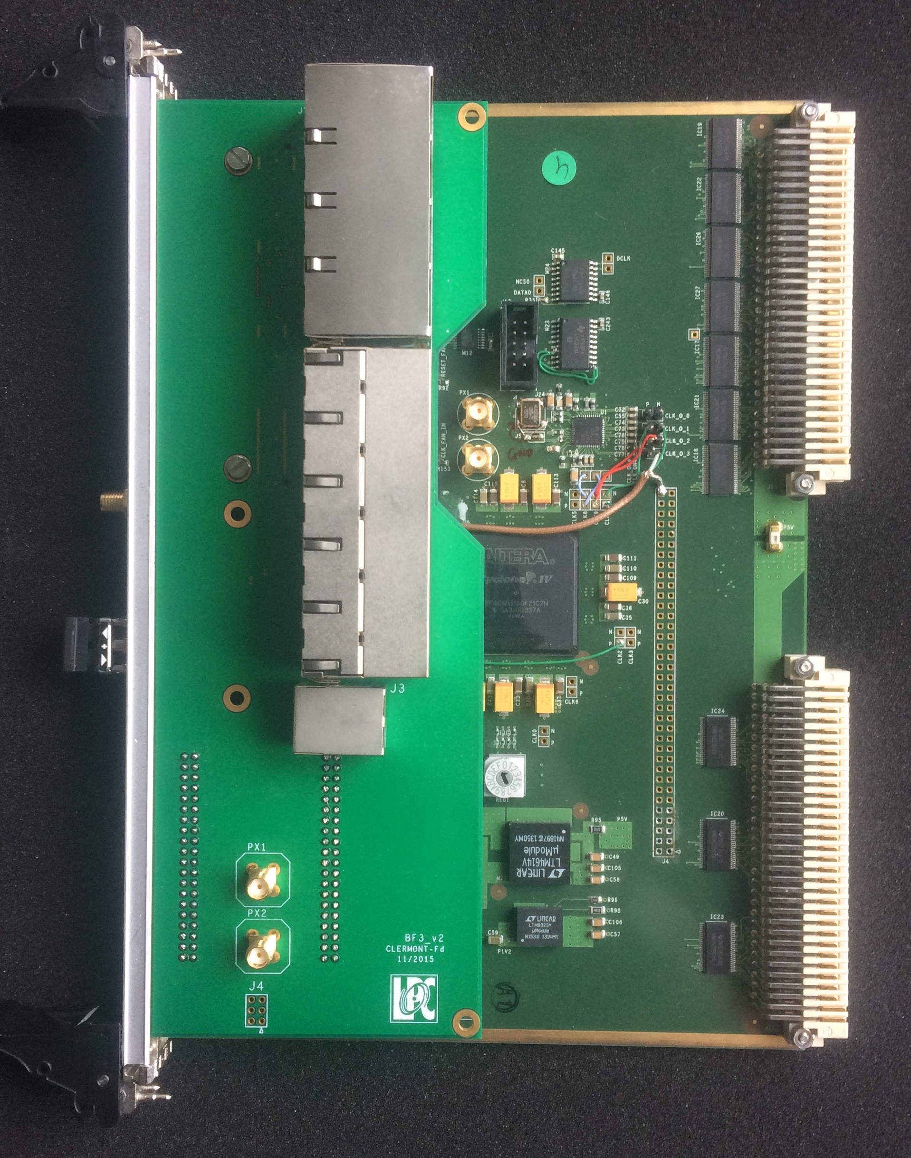
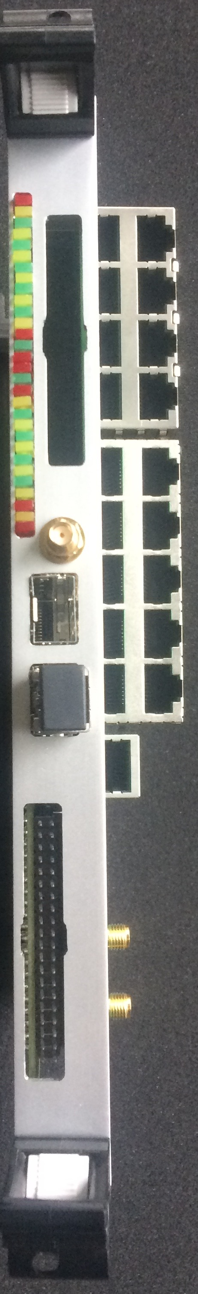

Slide 9
800 μm steps
Total area scanned per acquisition:
29.6 x 29.6 mm²
Total number of points per acquisition:
1369
(37 x 37 point matrix)

Slide 10
